Slide 1

Java SE 7 Features
Notes:
NOTE

Slide 2
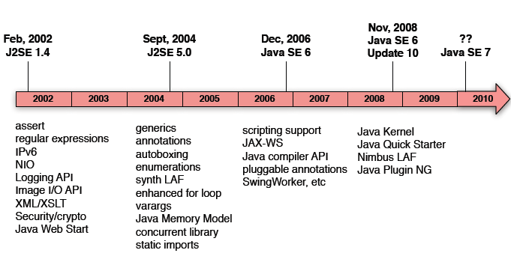
IDE Support: NetBeans 6.9.x, Eclipse Indigo, IntelliJ IDEA 10.5
Release Schedule
Completed features (July 2011)
JDK release for late 2012 -
Projects Lambda (closures), Jigsaw (modularity (jam, jar-hell)), Coin (lang. changes)
Notes:
NOTE

Slide 3
New features in Java 7
JSR 275 Units and Quantities JSR 310 Date and Time API JSR 203 NIO2 JSR 308 Annotations on Java Types Miscellaneous Language changes JSR 326 Post mortem JVM Diagnostics API JSR 260 Javadoc Technology Update JSR 255 JMX 2.0 JSR 262 Web Services Connector for JMX G1 garbage collector | JSR 166 Concurrency Utilities JSR 225 XQuery API for Java JSR 284 Resource Consumption Management JSR 296: Swing Application Framework JSR 292: Supporting Dynamically Typed Languages on the Java Platform JSR 107 Cache API JSR 295 Beans Binding JSR 303 Beans Validation and more …

Slide 4
JSR 310 Date and Time API
Date date = new Date(2011, 12, 27, 23, 59, 59); //Is this right?
//correction
int year = 2011 - 1900; //
int month = 12 - 1; // month - 0 to 11
Date date = new Date(year, month, 27, 23, 59, 59);
Other Problems • Date, Calendar, SimpleDateFormatter are mutable • TimeZone.getInstance() exception handling • GregorianCalendar time + zone constructor • Calendars can’t be formatted • java.sql.Date, Time, Timestamp subclass poorly • Formatters can’t format Timestamp nanos • Date does not represent a date

Slide 5
JSR 310 Date and Time API
new Date and Time • Continuous Time (Instants, Intervals, and Durations) • Human Scale Time (not tied to TimeZone or Instant) more on • Matchers, Adjusters, Resolvers • Full time zone rule support • Periods: “8 years, 2 months” • Formatting and parsing Integration • Date, Calendar, etc - retroﬁt with interfaces • JDBC - map to SQL types • XML Schema - based on same standard so should be straightforward

Slide 6
JSR 203 NIO2
java.io.File problems • Many methods return boolean • No copy / move support • No symbolic link support • No change notiﬁcation support • Limited support for ﬁle attributes • Not extensible

Slide 7
JSR 203 NIO2
New ﬁle system API • FileRef - represents ﬁle object in system • Path - extends FileRef, binds a ﬁle to a system-dependent location • FileSystem - interface to ﬁle system • FileStore - underlying storage system • Asynchronous I/O on sockets and ﬁles • Completion of socket channel work

Slide 8
JSR 203 NIO2
NetworkChannel • Finish work on channel to network socket, • Multicasting • DatagramChannel (now supports), • AsynchronousDatagramChannel (new) • Asynchronous I/O for ﬁles and sockets • Future or callback style • Group support - manage thread pools

Slide 9
Miscellaneous Language Changes
Some possible smaller language enhancements include:
Strings in switch statements
Binary literals
Comparisons for Enums
Chained invocations
Extension methods
Improved catch
Null-safe handling
BigDecimal operator support

Slide 10
JSR 166 Concurrency Utilities
JSR 166 is a new parallel-processing package called fork/join.
The core of the fork/join library is a new class called ForkJoinPool (effectively a thread pool) and a set of task types for decomposing problems.
A ParallelArray is a set of your domain items whose work is backed by a ForkJoinPool. You can define many common functional operators -- such as filter, map, and apply them to a ParallelArray.

Slide 11
References
http://www.oracle.com/technetwork/java/7-138633.html
http://openjdk.java.net/projects/jdk7/features/
http://jdk7.java.net/
http://www.javaworld.com

Slide 12

The End

